Slide 1
SITE RELIABILITY ENGINEERING (SRE)
STRATEGY

Slide 2
HomeAgain Site Reliability Engineering
Leveraging SRE Principles and Practices for HomeAgain

Slide 3
PROBLEM DOMAIN
Existing System's Growth in Complexity and Traffic Volume
Development Velocity vs. Operational Stability
Scalability and Reliability
Managing Risk
Software Fault Tolerance
Monitoring and Alerting Systems
Automation
Continuous Build and Deployment
Configuration Management
Minimal APIs
Cloud Elasticity

Slide 4
PROPOSED SOLUTION
Site Reliability Engineering (SRE)
SRE is what you get when you treat operations as if it's a software problem.
Tenets of SRE
Availability
Latency
Performance
Efficiency
Change Management
Monitoring
Emergency Response
Capacity Planning

Slide 5
KEY SRE PRINCIPLES AND PRACTICES
Service Level Indicator (SLI)
A quantifiable measure of service reliability.
Service Level Objective (SLO)
A binding target for a collection of SLIs.
Service Level Agreement (SLA)
A business agreement between a customer and service provider based on SLOs.
Error Budget
An SLO implied acceptable level of unreliability.
Toil
Work directly tied to running a service that is manual, repetitive, etc.
Blameless Postmortem
A truly blameless postmortem culture results in more reliable systems.
Notes:
Service Level Indicator (SLI)
In other words, a quantifiable measure of the reliability of your service from your users' perspective.
Good SLIs are a measurable analogy for user happiness.
SLIs - Metrics Over Time:
Request latency
Batch throughput
Failures per request
Service Level Objective (SLO)
In other words, SLO sets a reliability target for an SLI over a period of time.
An SLO is fundamental tool for prioritizing reliability versus other features, and communicating the expectations of a service through objective data.
An SLO is an internal promise to meet customer expectations.
Being out of SLO must have consequences which redirect engineering effort towards making reliability improvements.
SLOs should capture the performance and availability levels that, if barely met, would keep the typical customer of a service happy:
"Meeting SLO Targets" => "Happy Customers"
"Sad Customers" => "Missing SLO Targets“
Service Level Agreement (SLA)
In other words, an external promise that comes with consequences.
An SLA describes the minimum level of service you promise to provide and what happens otherwise.
Error Budget
An SLO implies an acceptable level of unreliability and this is a budget that can be allocated.
Benefits of Error Budget
Common incentive for devs and SREs:
Find the right balance between innovation and reliability.
Dev team can manage the risk themselves:
They decide how to spend their error budget.
Unrealistic reliability goals become unattractive:
These goals dampen the velocity of innovation.
Dev team becomes self-policing:
The error budget is a valuable resource for them.
Shared responsibility for system uptime:
Infrastructure failures eat into the error budget.

Slide 6
SLIs, SLOs, and SLAs
SLIs drive SLOs which inform SLAs.
SLI ranges from 0% to 100%.
0% means nothing works.
100% means nothing is broken.
This scale lends itself to the concept of an Error Budget.
SLO is a target percentage.
Error Budget = 100% - SLO
Good Events
× 100%
SLI =
Valid Events

Slide 7
ERROR BUDGET
A way of tracking the aggregate reliability of a service over time.
Accompanied by the organization's response should it be exhausted.
Product Management defines an SLO.
Sets expected uptime the service should have per period.
Actual uptime is measured by a neutral third party.
Difference between these two numbers is Error Budget.
If Error Budget is Remaining
Increase the release cadency or feature velocity.
Deploy more beta features, conducting more disruptive testing.
Or simply operate at a greater level of reliability.
If Error Budget is Exhausted
React in the service- or organizationally-specific way agreed upon.

Slide 8
TOIL
Toil is work tied to running a production service that tends to be
manual, repetitive, automatable, reactive, devoid of enduring value, and scales linearly
Task that needs human judgment may or may not be toil.
Reducing toil and scaling up services are the Engineering in SRE.
Eliminating Toil
Identify and Measure Toil
Engineer Toil Out of the System
Reject the Toil
Use SLOs to Reduce Toil
Promote Toil Reduction as a Feature
Automate Toil Response
Suggested Breakdown of Work for an SRE
50% engineering work and 50% operational work including toil-intensive work.
50% is seen as an upper bound on operational load, smaller would be better.

Slide 9
BLAMELESS POSTMORTEM
Ensures the incident is documented and causes are understood.
Puts preventive actions in place to reduce the recurrence.
Defines the postmortem criteria before an incident occurs.
Identifies the causes of an incident without indicting anyone.
Assumes that everyone in an incident had good intentions.
Mistake is seen as an opportunity to strengthen the system.
Triggers of Postmortem
User-visible downtime
Degradation beyond a certain threshold
Data loss of any kind
Release rollback
Rerouting of traffic
Resolution time above some threshold
Monitoring failure

Slide 10
SRE ENGAGEMENT MODEL
Architecture and Design Phase
Create best practices, and document the do and don'ts of infrastructure systems.
Participate in architecture and design discussion, development work, and codesign part of the service.
Active Development Phase
Productionize viz. capacity planning, setting up extra resources for redundancy, load balancing, etc.
Ensure proper monitoring coverage and help create alerts.
Limited Availability Phase
Help measure and evaluate reliability, and scale the system.
Defining SLOs before general availability (GA).
General Availability Phase
Perform the majority of operational work.
Deprecation Phase
Operate the existing system mostly without involvement from the developer team.
Support the transition with development and operational work.
Abandoned Phase
Support service incidents on a best-effort basis.
Hand over service management to any remaining users.
Unsupported Phase
Delete references to the service in production configurations and in documentation.

Slide 11
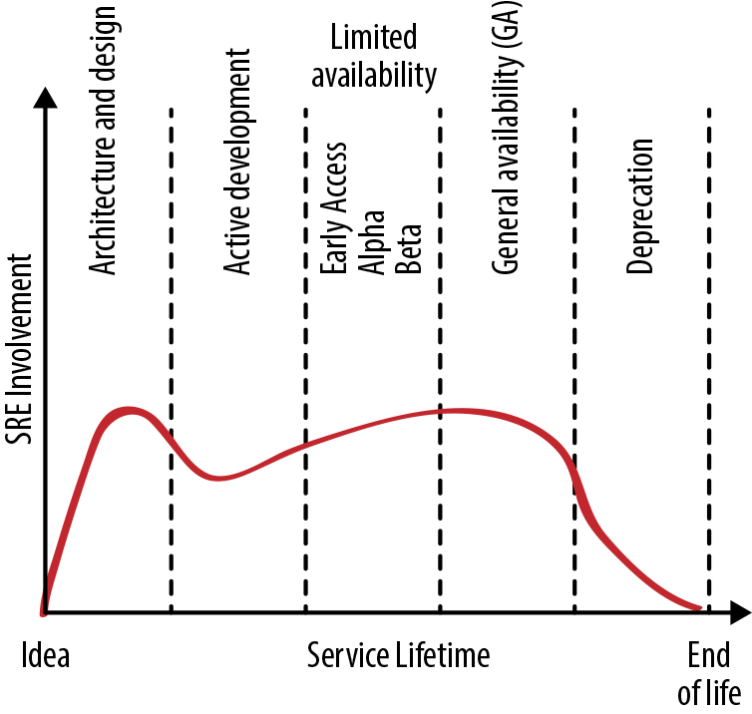
SRE ENGAGEMENT DURING THE SERVICE LIFECYCLE

Slide 12
SRE TEAM IMPLEMENTATIONS
Pros
Easy to get started on an SRE journey without organizational change.
Lets you test and adapt SRE practices to your environment at low cost.
Cons
Time management between day-to-day job demands vs. adoption of SRE practices.
Recommended for Organizations
Without the scale to justify dedicated SRE team staffing.
Experimenting with SRE practices before broader adoption.
Types of SRE Team Implementations
Kitchen Sink, a.k.a. "Everything SRE"
Infrastructure
Tools
Product/Application
Embedded
Consulting

Slide 13
1. KITCHEN SINK, 2. INFRASTRUCTURE
Kitchen Sink, a.k.a. "Everything SRE"
An SRE team where the scope of services or workflows covered is usually unbounded.
Pros
No coverage gaps between SRE teams.
Easy to spot patterns and draw similarities between services and projects.
Cons
Risk of overloading the team.
Tends to move from having positive impact to making shallow contributions.
Recommended for a company with just a couple of applications and user journeys.
Infrastructure
SRE teams focus on behind-the-scenes efforts that make other teams' jobs faster/easier.
Pros
Allows product developers to use DevOps practices to maintain user-facing products.
SREs can focus on providing a highly reliable infrastructure.
Cons
Focus on infrastructure improvements that are not necessarily tied to the customer experience.
Splitting the infrastructure teams may be required as the company and system complexity grows.
Recommended for any company with several development teams.

Slide 14
3. TOOLS, 4. PRODUCT/APPLICATION
Tools
A tools-only SRE team focuses on building software to help their developer counterparts.
Pros and cons of infrastructure and tools teams tend to be similar.
Cons additional to tools teams
Need to ensure tools team doesn't unintentionally turn into an infrastructure team, and vice versa.
High risk of an increase of toil and overall workload.
Recommended for any company that needs highly specialized reliability-related tooling.
Product/Application
SRE team works to improve reliability of a critical application or business area.
Pros
Provides a clear focus for the team's effort.
Allows a clear link from business priorities to where team effort is spent.
Cons
Product focus of each team can lead to duplication of base infrastructure.
Divergence of practices between teams, which is inefficient and limits knowledge sharing.
Recommended as second or nth team for companies with dedicated set of SREs.

Slide 15
5. EMBEDDED, 6. CONSULTING
Embedded
SREs embedded with their developer counterparts, usually one per dev team in scope.
Pros
Enables focused SRE expertise to be directed to specific problems or teams.
Allows side-by-side demonstration of SRE practices, which can be an effective teaching method.
Cons
It may result in lack of standardization between teams, and/or divergence in practice.
SREs may not have the chance to spend much time with peers to mentor them.
Recommended for starting an SRE function or scaling another implementation further.
Consulting
Arguably, a hybrid of consulting and tools implementations.
Pros
Helps with further scaling an existing SRE organization's positive impact.
Being decoupled from directly changing code and configuration.
Cons
Consultants may lack sufficient context to offer useful advice.
Being perceived as hands-off due to avoidance of changing code and configuration.
Recommended when demands have outgrown the support by other implementations.

Slide 16
SRE TEAM LIFECYCLES FOR HOMEAGAIN
SRE Practices Without SREs
Acknowledge that 100% is not the right reliability target.
Set a reasonable SLO target.
Agree on an error budget policy that will help defend your user experience.
Measure the SLO and commit to following the error budget policy.
Starting an SRE Team
Creating a new team as part of the project
Establishing a horizontal SRE team (a team of SREs consults across a number of teams)
Converting an existing team (for example, an operations team)
Forming
The team assembled should have combined experience and expertise.
Storming
Once assembled, the team needs to start working collaboratively.
Norming
Norming entails reaching broad agreement on best practices for the organization’s SRE teams.
Performing
Partner on all architecture design and change with complete workload self-determination.

Slide 17
REFERENCES
https://landing.google.com/sre/
https://cloud.google.com/blog/products/devops-sre
https://docs.microsoft.com/en-us/learn/paths/az-400-develop-sre-strategy/

Slide 18
END
Leveraging SRE Principles and Practices for HomeAgain

